Slide 1
skinMD
Group R1:
Aldrin Abastillas
Bezhou Feng
Lisa Jiang
Ryan Nakasone

Slide 2
Motivation
Skin Disease
Medical Concerns
Affects more than 100 million Americans
25% of Americans do not seek medical attention when sick or injured
Popular websites increase subjectivity in self-diagnosis
Early diagnosis is important for successful treatment

Slide 3
Goals
Goal #1
Goal #2
Develop a system which allows users to take pictures of their skin and identify the presence of a variety of skin conditions
Develop image-processing algorithm
Allow this system to be accessible on mobile devices
Create a smartphone application
Set up server to execute algorithm
Link user to online resources

Slide 4
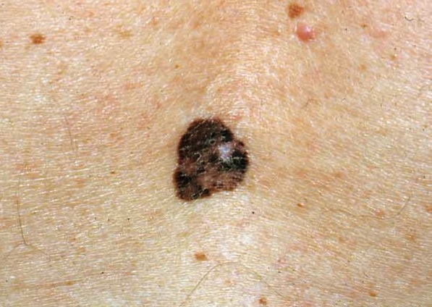
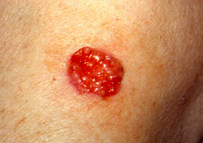
Background
Melanoma
Basal Cell Carcinoma
Most aggressive form of skin cancer
Most common form of skin cancer in the U.S.
Survival rate drops from 95% to 19% as condition progresses
Affects 718,000 people
Affects 2.8 million people

Slide 5
Process Overview
Find area of concern on skin

Slide 6
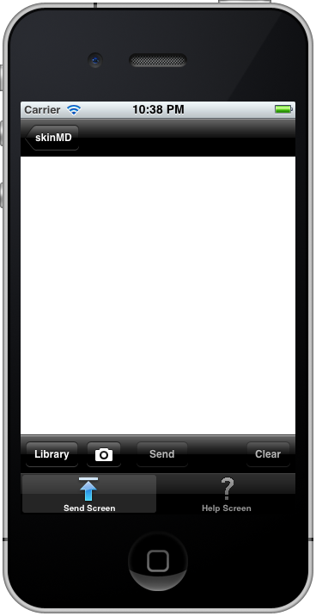
Process Overview
Photograph Area of Interest On Skin

Slide 7
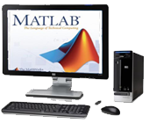
Process Overview
Send image to server with image analysis algorithm
Receive diagnosis from server

Slide 8
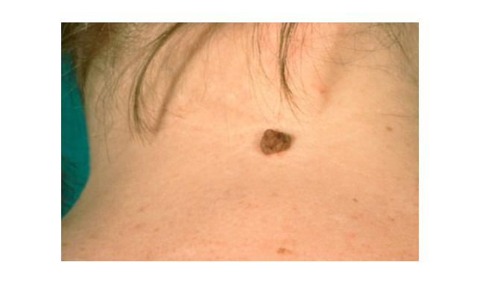
Algorithm: Process
Segmentation

Slide 9
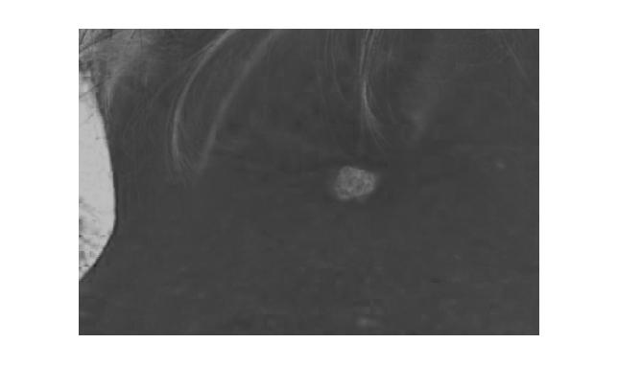
Algorithm: Process
Segmentation

Slide 10
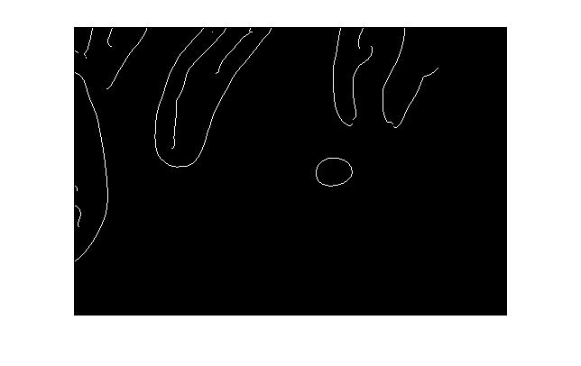
Algorithm: Process
Segmentation

Slide 11
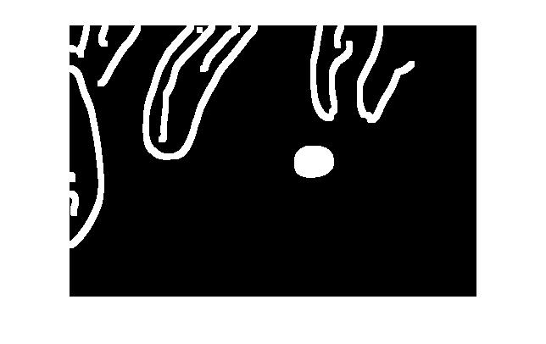
Algorithm: Process
Segmentation

Slide 12

Algorithm: Process
Segmentation

Slide 13
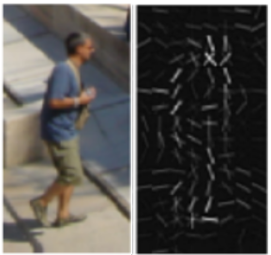
Algorithm: Process
Histogram of Oriented Gradients
Features
Border irregularity
Asymmetry
Diameter
RGB color ratios

Slide 14
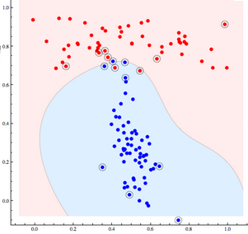
Algorithm: Process
SVM
Melanoma training model
Basal cell carcinoma (BCC) training model
Predictions
SVM results
Threshold feature consideration

Slide 15
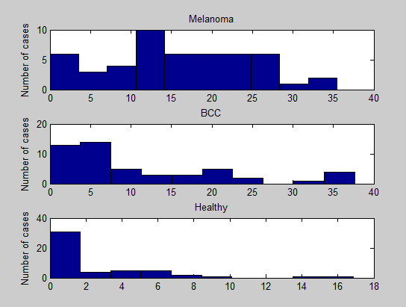
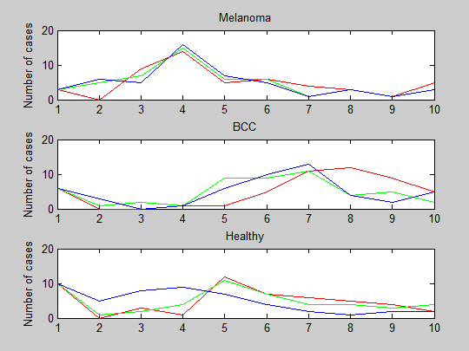
Algorithm: Features
Border Irregularity
RGB Channels

Slide 16
Specification: Accuracy
Sensitivity
Ability to correctly diagnose disease
Specificity
Ability to correctly diagnose absence of disease
Database
Evaluating algorithm using photos from clinical trial databases
Confidence Level: 95%, Confidence Interval: ±5%
Minimum sample size needed: 384 photos
Melanoma ≥ 80 %
Basal Cell Carcinoma ≥ 70 %
Melanoma ≥ 90 %
Basal Cell Carcinoma ≥ 80 %
Notes:
ADD Citation

Slide 17
Results: Accuracy
SVM + Feature Analysis
Melanoma
Sensitivity: 68.17%
Specificity: 79.96%
BCC
Sensitivity: 77.08%
Specificity: 97.85%
SVM
Melanoma
Sensitivity: 77.85%
Specificity: 27.57%
BCC
Sensitivity: 95.57%
Specificity: 36.76%

Slide 18
Specification: Analysis Speed
Round trip no more than 60 seconds

Slide 19
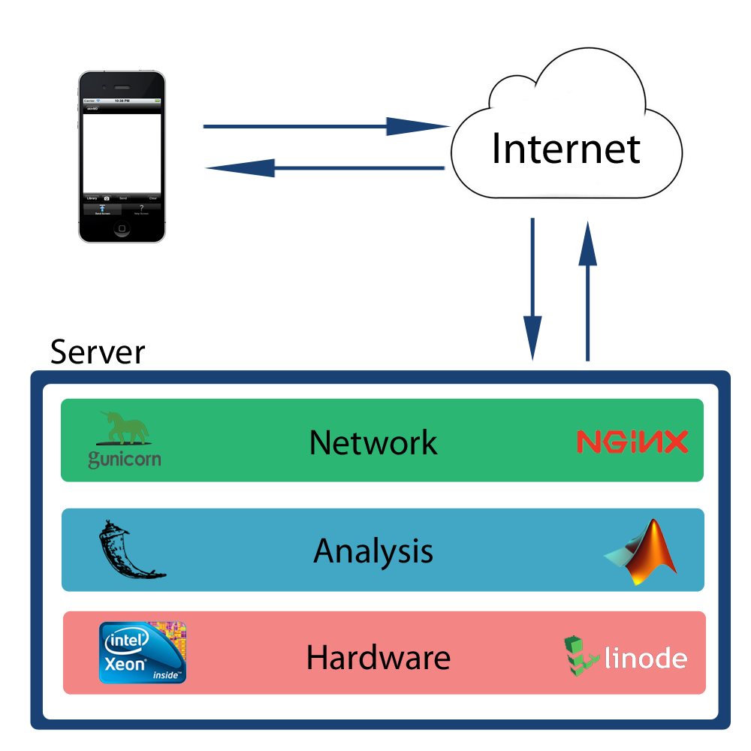
Specification: Analysis Speed
Server Architecture

Slide 20
Results: Analysis Speed
Server Performance:
0.82 ± 0.01 seconds per image
Average performance over 1750 runs
Linear Growth

Slide 21
Results: Analysis Speed
Total Performance (server and phone)
5.05 ± 0.44 seconds per analysis
Average performance over 21 runs
Using iPhone 3GS on AT&T’s 3G cellphone network
Time usage

Slide 22
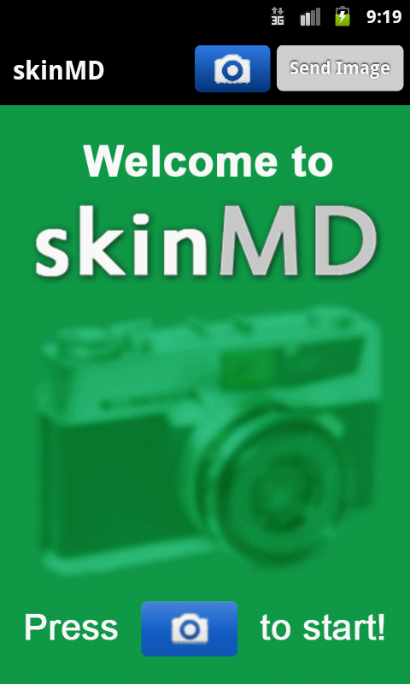
Specification: Ease of Use
Simple Interfaces
Apple iOS
Google Android

Slide 23
Specification: Ease of Use
Number of Buttons
One for camera
Usability
Successfully execute program within 1 minute
Adhering to Human Interface Guidelines
One to both send and receive data

Slide 24
Ease of Use - Results
User Experience Survey
Navigation: 93.0%
FAQs: 89.6%
Not freezing or crashing: 100%
Overall Rating: 88.8%

Slide 25
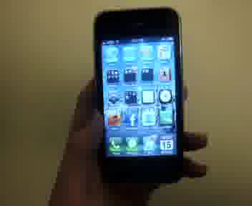
Demonstration

Slide 26
Expenses
Item | Use | Cost
MATLAB Software | Algorithm Programming | $0; through SEAS Computing
Apple Developer Membership | iOS Programming Development and distribution rights | $0; through U. Penn Purchasing Services
Android Developer Membership | Development and distribution rights | $0; previously purchased
Virtual Server Hosting Package | Downloading image data, executing algorithm, sending results | $60.57; renting for 2 months from Linode.com
TOTAL |  | $60.57

Slide 27
Future Recommendations
More Data
Finding larger image databases
Algorithm
Distributing survey to more people
More time researching edge detection

Slide 28
Acknowledgments
Project Advisor
Dr. Brian Litt
Medical Image Database
Dr. Scott Umbaugh, Southern Illinois University Edwardsville
Senior Design Advisors
Dr. Michael Rizk
Dr. Chelsea Salinas
Dr. Beth Winklestein

